Slide 1
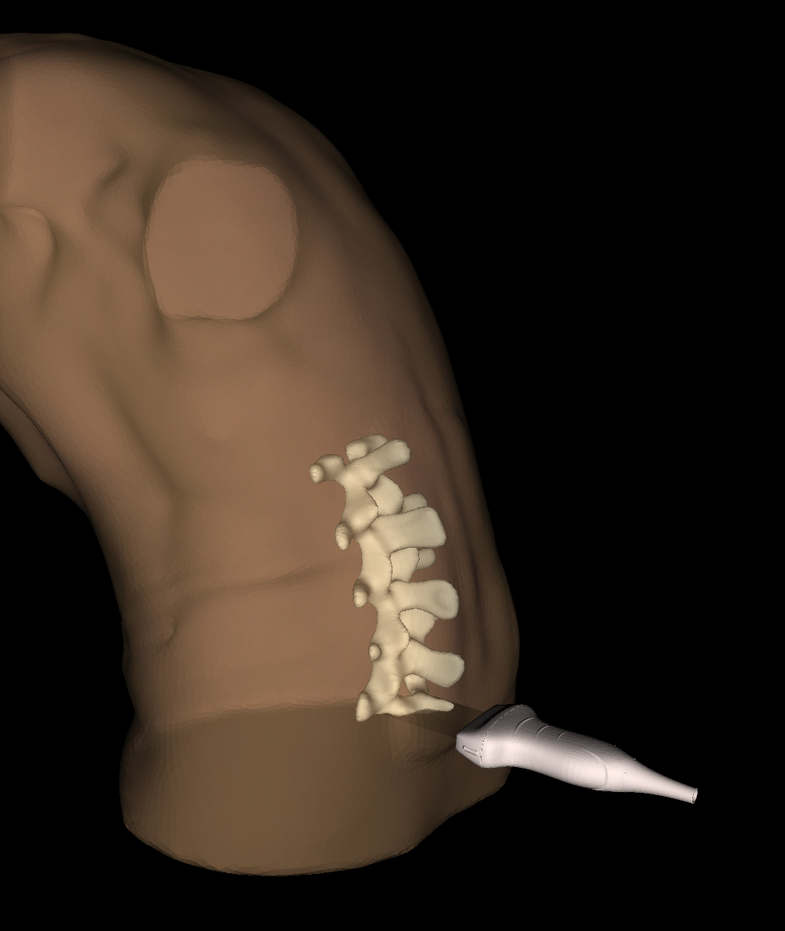
LUMBAR INSERTION
Localize the spinous process of L5 vertebra placing the ultrasound probe in a transverse plane.

Slide 2
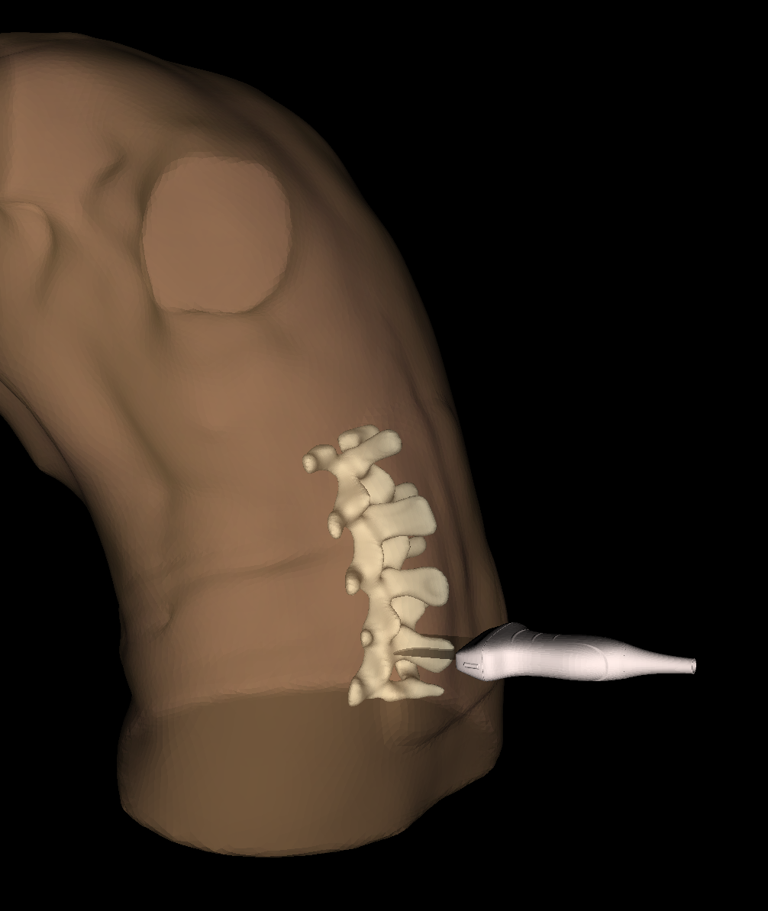
LUMBAR INSERTION
Localize the spinous process of L4 vertebra placing the ultrasound probe in a transverse plane.

Slide 3
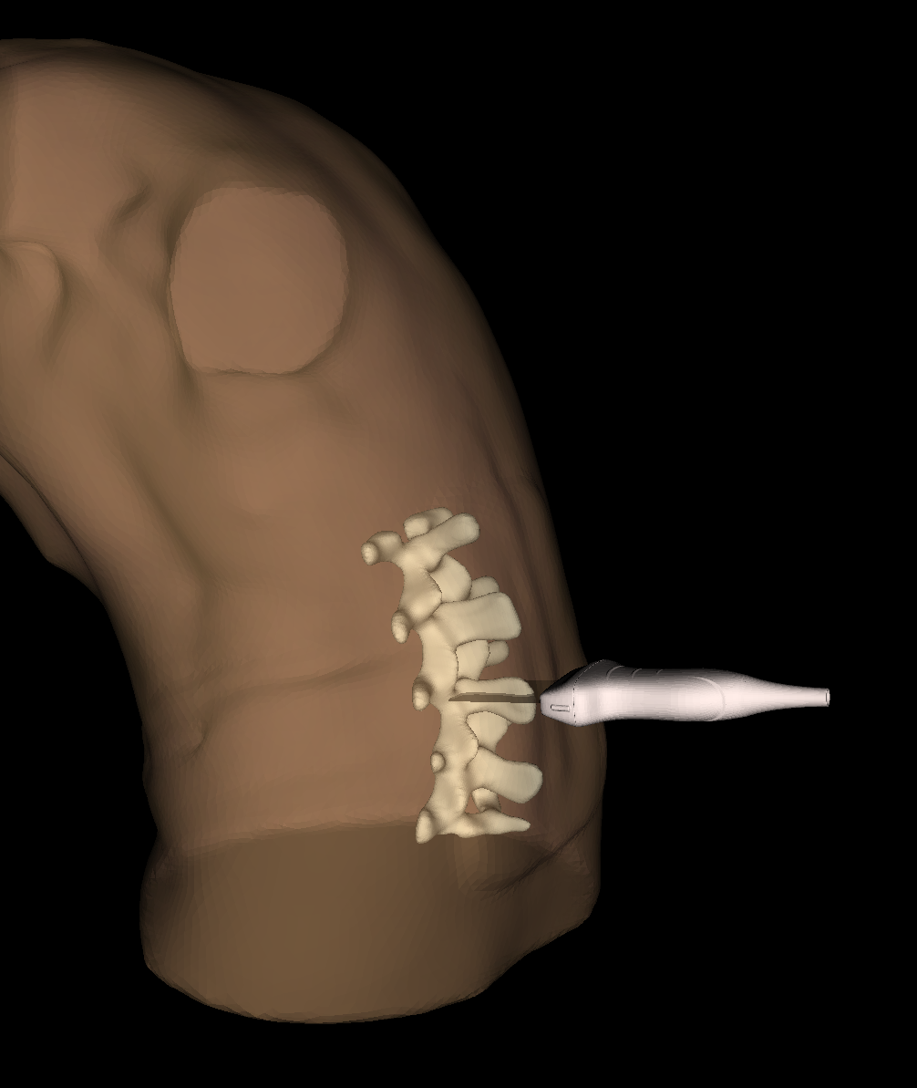
LUMBAR INSERTION
Localize the spinous process of L3 vertebra placing the ultrasound probe in a transverse plane.

Slide 4
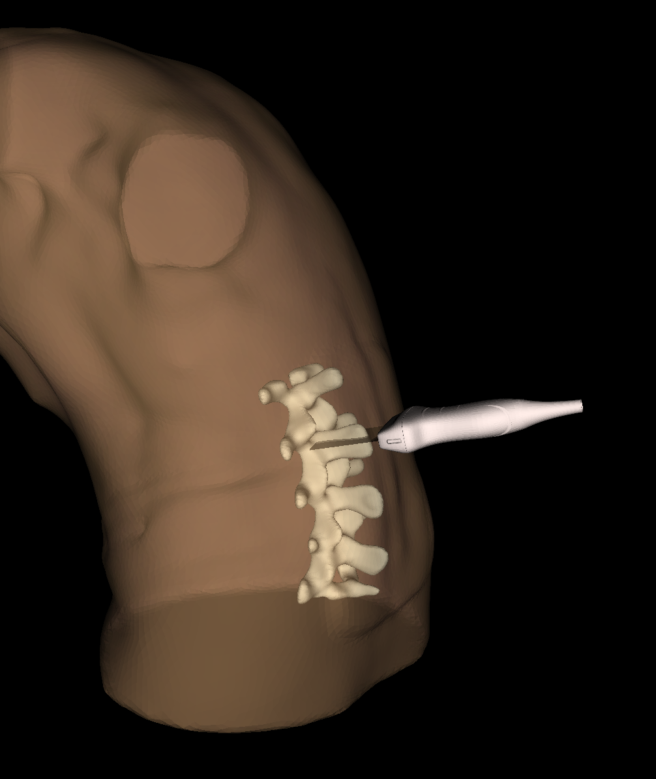
LUMBAR INSERTION
Localize the spinous process of L2 vertebra placing the ultrasound probe in a transverse plane.

Slide 5
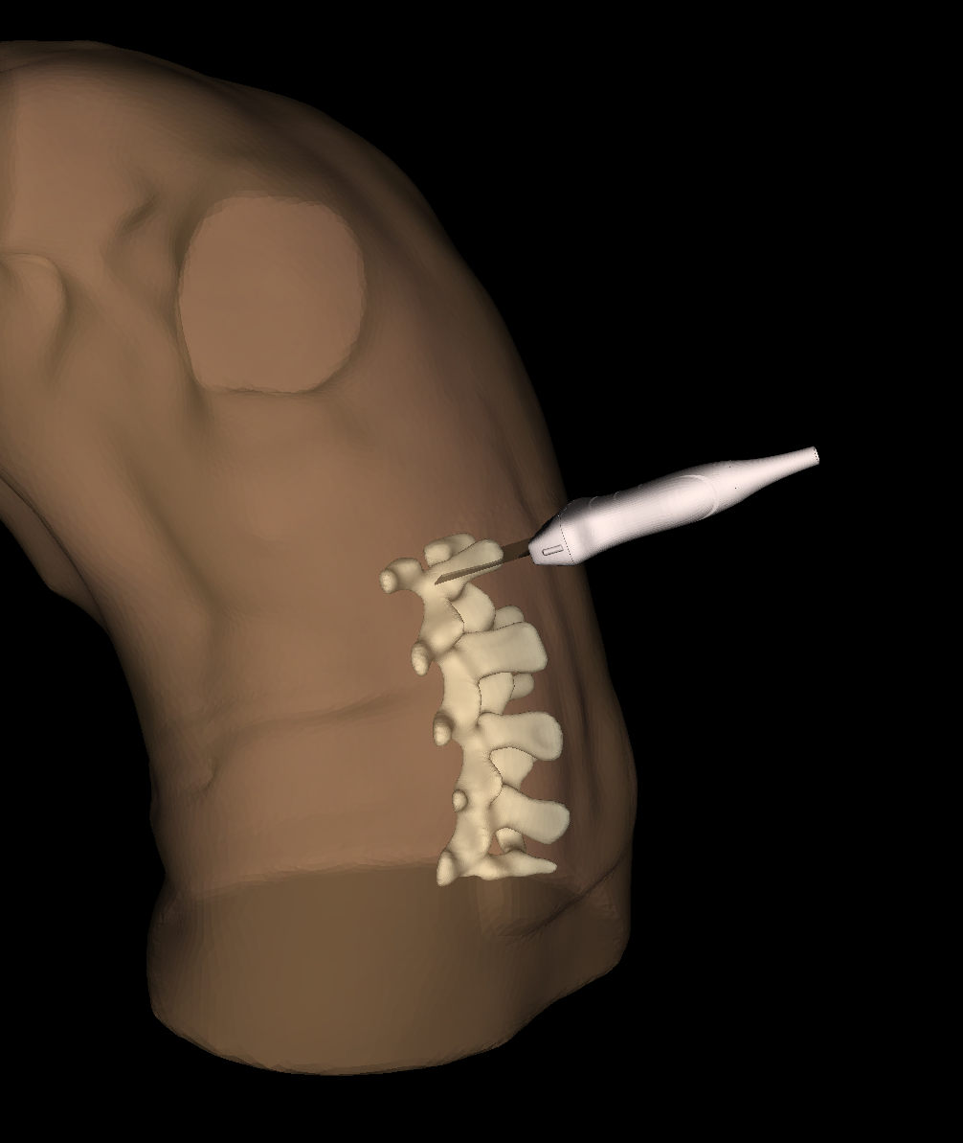
LUMBAR INSERTION
Localize the spinous process of L1 vertebra placing the ultrasound probe in a transverse plane.

Slide 6
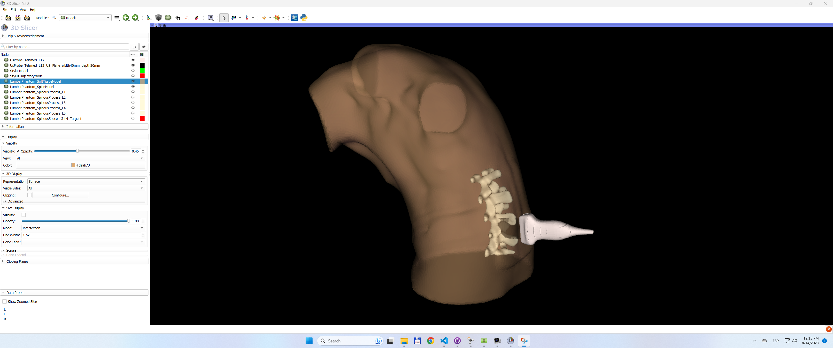
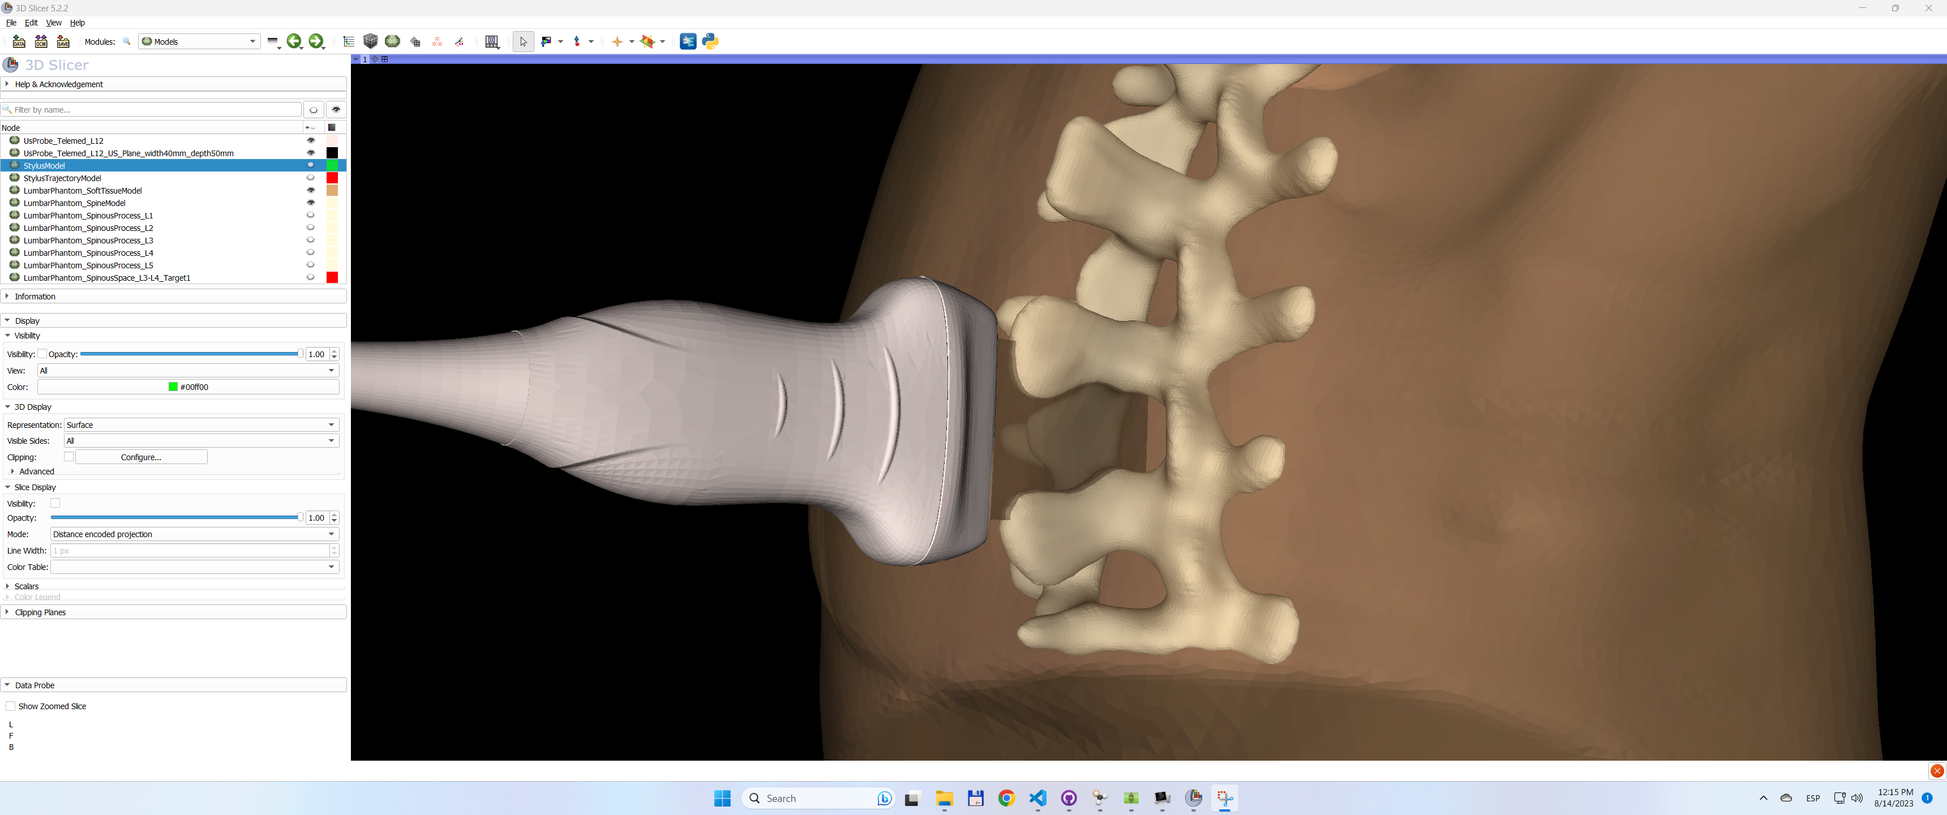
LUMBAR INSERTION
Localize the L3-L4 interspinous space aligning the ultrasound probe beam longitudinally over the midline.

Slide 7
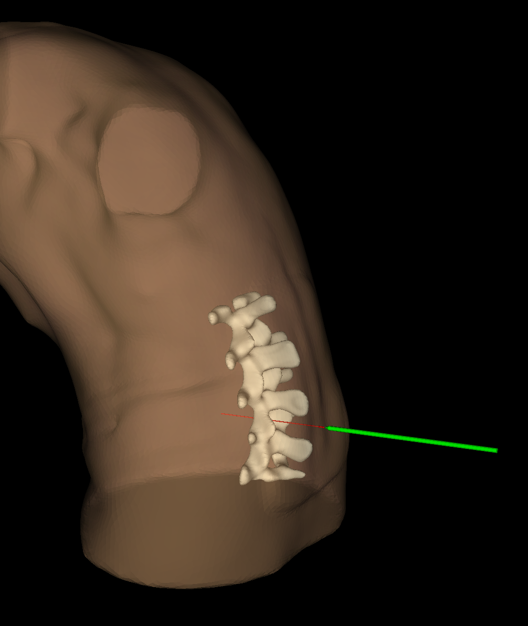
LUMBAR INSERTION
Position the needle tip in contact with the skin surface and rotate the needle to follow the most appropriate trajectory to reach the ligamentum flavum traversing the L3-L4 interspinous space.

Slide 8
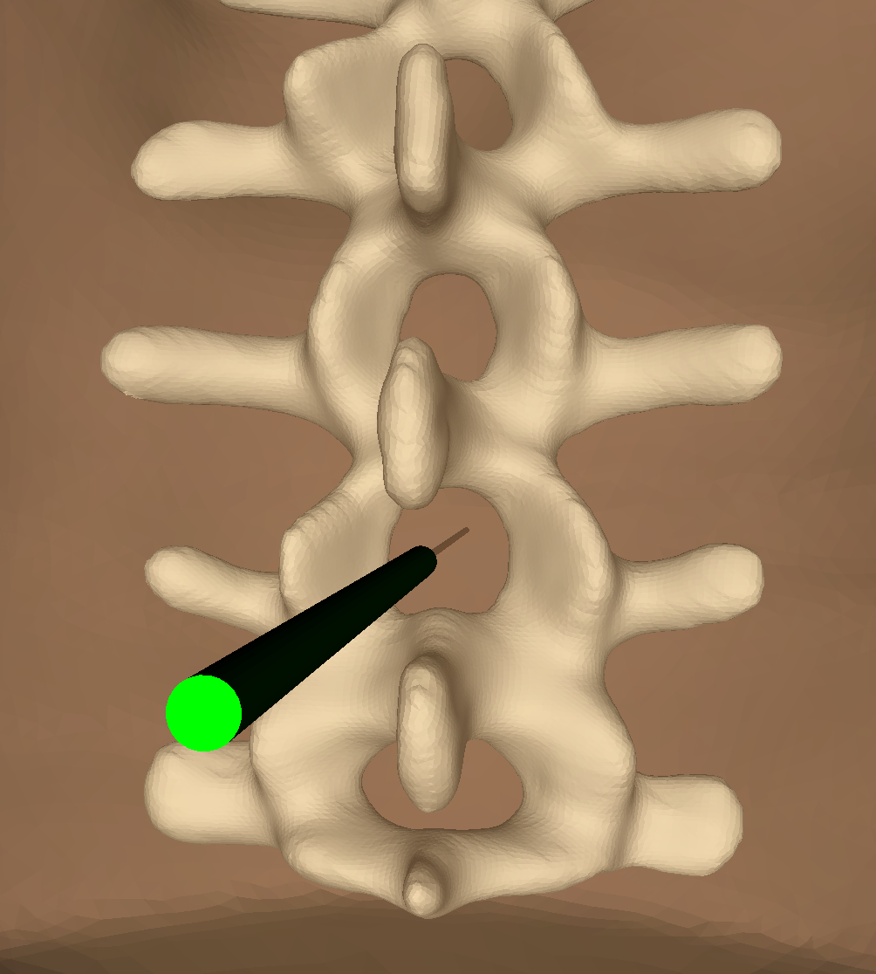
LUMBAR INSERTION
Perform needle insertion to reach target.

